Slide 1
IBM SKILLSBUILD PROJECT
SUBMITTED BY:
NAME- Upanchit Senapati
BRANCH- CSE(AIML)
COLLEGE/UNIVERSITY- C V Raman Global University
ORGANIZATION- DGT
STUDENT ID: STU645bc8f508b2b1683736821
INTERNSHIP ID: INTERNSHIP_168198413964410a8b547b1
EMAIL ID: 20010347@cgu-odisha.ac.in

Slide 2
SUPERSTORE DATA ANALYSIS
INTRODUCTION:
The goal of this project is to analyze the Superstore dataset to gain insights into sales trends, customer behavior, and operational efficiency. The dataset contains information about various aspects of the store's operations, including sales, customer demographics, product categories, and geographical regions.
Major steps were taken by the business organization:
Data Collection and Preprocessing.
Sales Analysis: Customer Behavior Analysis.
Exploratory Data Analysis (EDA).
Operational Efficiency Analysis.
PROBLEM STATEMENT:
The Super Store, a large retail chain, has accumulated vast amounts of data related to its operations, including sales, inventory, customer demographics, and product details. However, the Super Store currently lacks an effective data analysis system that can extract actionable insights from the available data.

Slide 3
agenda
Sl No. | Topic Name | Page
1 | PROJECT OVERVIEW | 4
2 | WHO ARE THE END USERS OF THIS PROJECT? | 5
3 | SOLUTION AND ITS VALUE PROPOSITION | 6
4 | HOW DID YOU CUSTOMIZE THE PROJECT AND MAKE IT YOUR OWN | 7
5 | MODELLING | 8-9
6 | RESULTS | 10
7 | CONCLUSION & LINKS | 11-12

Slide 4
PROJECT OVERVIEW
The analysis of the Superstore dataset is a comprehensive study that aims to analyze the sales performance of a fictional retail company called "Superstore". The dataset used in this analysis contains information about sales transactions, customers, products, and geographical locations.
PURPOSE:
Gain insights into sales trends, customer behavior, and operational efficiency in order to optimize store performance and make data-driven recommendations for improvement.
SCOPE:
Includes examining the Superstore dataset, which consists of sales transactions, customer demographics, product categories, and geographical regions.
OBJECTIVE:
Identify sales trends, such as seasonal patterns and fluctuations, to optimize inventory management and sales forecasting.
Understand customer behavior by analyzing demographics, preferences, and purchase patterns to develop targeted marketing strategies and enhance customer satisfaction.
Improve operational efficiency by identifying bottlenecks, streamlining processes, and optimizing resource allocation for enhanced profitability.
Provide data-driven recommendations to optimize store performance, improve customer experience, and increase overall profitability based on the analysis findings.

Slide 5
WHO ARE THE END USERS OF THIS PROJECT?
Store Managers:
They require insights into sales performance, customer behavior, and operational efficiency to make informed decisions and optimize store operations such as supply chain operations and inventory management.
Marketing Managers:
They need information on customer demographics, preferences, and buying patterns to develop targeted marketing campaigns and improve customer engagement.
The Management Team at Superstore:
This is the primary audience for the project's research and insights, which they will use to make strategic choices and put new ideas into practice to increase operations, sales, and profitability.
The Finance Team :
They can find ways to cut costs and enhance pricing strategies.
Data Analysts and Data Scientists:
They can contribute their knowledge in analyzing the information and drawing conclusions by using the project as a standard for future data-driven initiatives and a reference for analyses of a similar nature.

Slide 6
SOLUTION AND ITS VALUE PROPOSITION
Solution:
Involves conducting a comprehensive analysis of the Superstore dataset to gain insights into sales trends, customer behavior, and operational efficiency. This analysis will be carried out using various statistical and data mining techniques, as well as advanced visualization tools.
Value Proposition:
Data-Driven Decision Making.
Enhanced Profitability.
Customer Insights and Personalized Marketing.
Competitive Advantage

Slide 7
CUSTOMIZE THE PROJECT AND MAKE IT MY OWN
ADVANCED VISUALIZATION WITH MATPLOTLIB AND SEABORN: While data visualization is a common component of data analysis projects, my solution stands out by utilizing the powerful libraries Matplotlib and Seaborn. These libraries offer extensive customization options, allowing for the creation of visually appealing and insightful charts, graphs, and plots.
INTERACTIVE DASHBOARDS: Allow stakeholders to dynamically explore and interact with the analyzed data, enabling them to drill down into specific details, apply filters, and visualize different dimensions.
DESCRIPTIVE ANALYTICS: Utilize descriptive analytics techniques to summarize and present key information about sales trends, customer behavior, and operational performance within the Superstore dataset.
FORECASTING AND TREND ANALYSIS: Apply forecasting methods and trend analysis to predict future sales trends and demand patterns.

Slide 8
MODELLING
EXPLORATORY DATA ANALYSIS: EDA techniques were employed to gain initial insights into the dataset. This included data visualization through charts, graphs, and plots to understand the distribution of variables, identify outliers, and detect patterns or relationships between different variables.
STATISTICAL ANALYSIS: Utilized to uncover correlations, trends, and patterns within the Superstore dataset. These techniques helped in understanding the impact of various factors on sales, customer behavior, and operational efficiency.
CUSTOMER SEGMENTATION: Applied o categorize customers based on their attributes and buying behavior. This allowed for the identification of distinct customer groups with specific needs and preferences, enabling targeted marketing strategies.
DATA VISUALIZATION: Advanced data visualization techniques using tools like Python libraries (e.g., Matplotlib, Seaborn) were used to create visually appealing and informative charts, graphs, and dashboards. These visualizations facilitated the effective communication of analysis results and provided a clear representation of key findings.

Slide 9
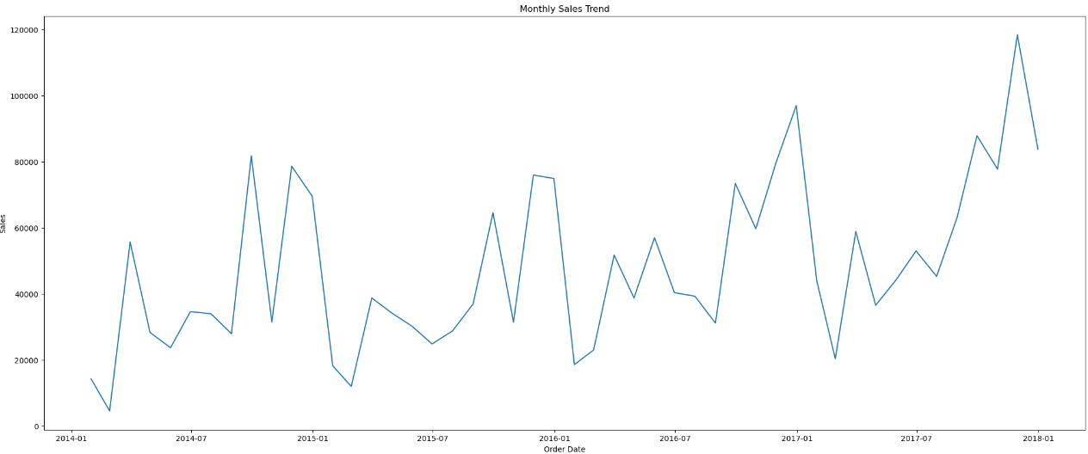
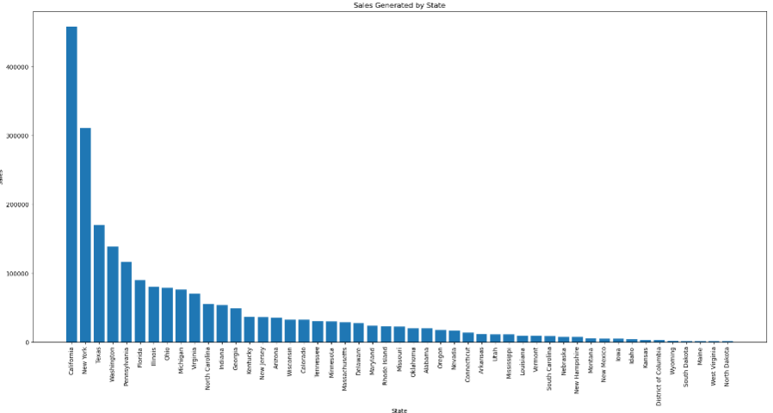
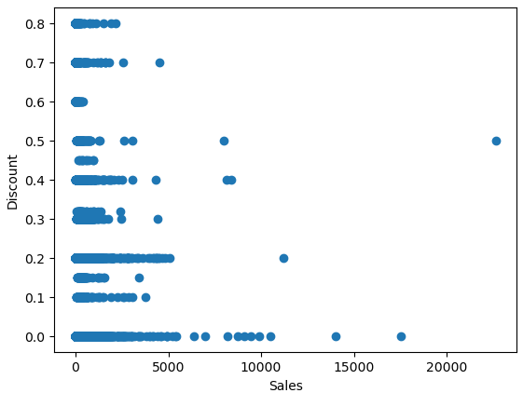
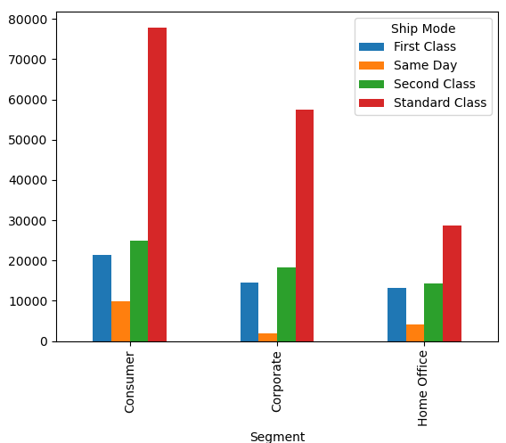

Slide 10
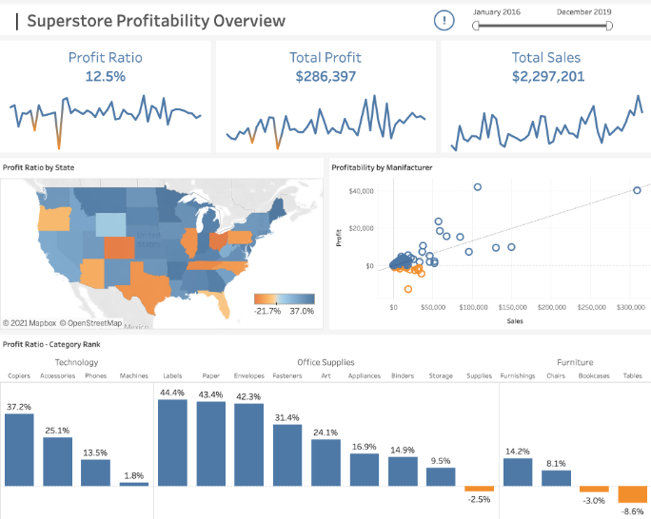
RESULTS

Slide 11
CONCLUSION
The analysis of the Superstore dataset has provided valuable insights into sales trends, customer behavior, and operational efficiency.
Moving forward, it is recommended that the Superstore continues to monitor sales performance, customer behavior, and operational metrics. This will allow for ongoing adjustments and improvements based on changing market dynamics and evolving customer preferences.
Overall, the "Analysis of Superstore dataset" project demonstrates the power of data analytics in uncovering insights that drive strategic decision-making, operational efficiency, and ultimately, the success of the Superstore in a competitive retail market.

Slide 12
LINKS
Data set URL: https://www.kaggle.com/datasets/vivek468/superstore-dataset-final
My Project URL(Please choose to open in Google Collaboratory): https://drive.google.com/file/d/1F2iNWh3KKf0b0nilPoNaHFxp0CzfdkfU/view?usp=sharing

